Slide 1
Digital Signal Processing(BEC-303)
Unit-1
Lecture-5
Presented By:
Dr. Ishwar Chandra Yadav

Slide 2
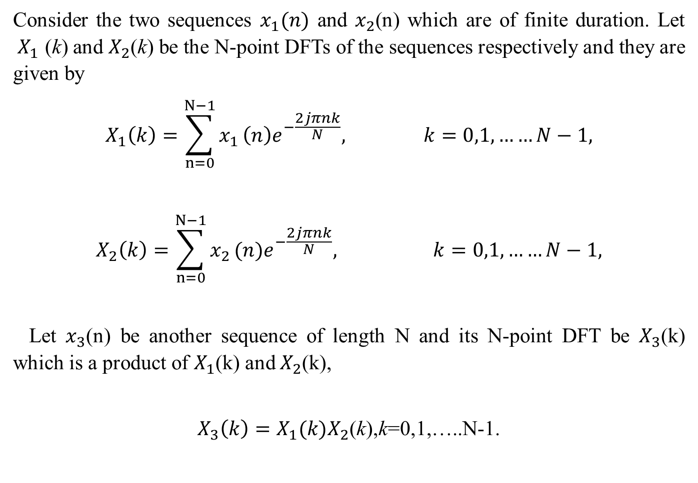
Circular Convolution (Periodic Convolution)
Consider the two sequences $x_{1}(n)$ and $x_{2}$(n) which are of finite duration. Let ${ X}_{1}$ (k) and $X_{2}$(k) be the N-point DFTs of the sequences respectively and they are given by
$$X_{1}\left(k\right)=\sum_{n=0}^{N−1}{x_{1}}\left(n\right)e^{−\frac{2jπnk}{N}}, k=0,1,……N−1,$$
$$X_{2}\left(k\right)=\sum_{n=0}^{N−1}{x_{2}}(n)e^{−\frac{2jπnk}{N}}, k=0,1,……N−1,$$
Let $x_{3}$(n) be another sequence of length N and its N-point DFT be $X_{3}$(k) which is a product of $X_{1}$(k) and $X_{2}$(k),
$X_{3}\left(k\right)=X_{1}{(k)X}_{2}$(k),k=0,1,…..N-1.

Slide 3
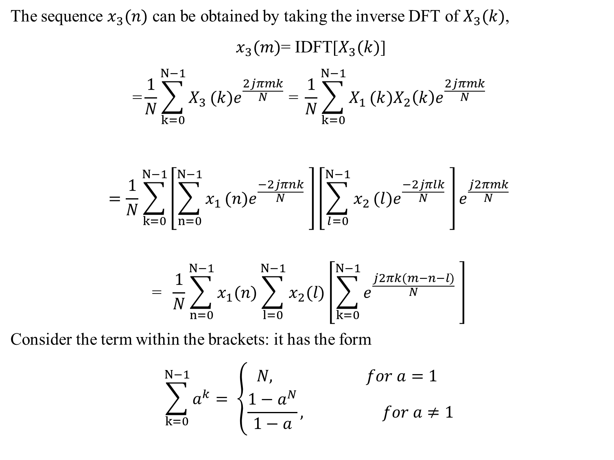
The sequence $x_{3}(n)$ can be obtained by taking the inverse DFT of $X_{3}(k)$,
$x_{3}(m)$= IDFT[$X_{3}(k)$]
$$\text{=}\frac{1}{N}\sum_{k=0}^{N−1}{X_{3}}(k)e^{\frac{2jπmk}{N}}\text{ = }\frac{1}{N}\sum_{k=0}^{N−1}{X_{1}}(k)X_{2}\left(k\right)e^{\frac{2jπmk}{N}}$$
$$=\frac{1}{N}\sum_{k=0}^{N−1}{\left[\sum_{n=0}^{N−1}{x_{1}}(n)e^{\frac{−2jπnk}{N}} \right]}\left[\sum_{l=0}^{N−1}{x_{2}}(l)e^{\frac{−2jπlk}{N}} \right]e^{\frac{j2πmk}{N}}$$
$$\text{= }\frac{1}{N}\sum_{n=0}^{N−1}{x_{1}(n)}\sum_{l=0}^{N−1}{x_{2}(l)}\left[\sum_{k=0}^{N−1}{e^{\frac{j2πk(m−n−l)}{N}}} \right]$$
Consider the term within the brackets: it has the form
$$\sum_{k=0}^{N−1}{a^{k}= \left\{\begin{aligned}N, for a=1 \\ \frac{1−a^{N}}{1−a}, for a≠1\end{aligned}\right.}$$

Slide 4
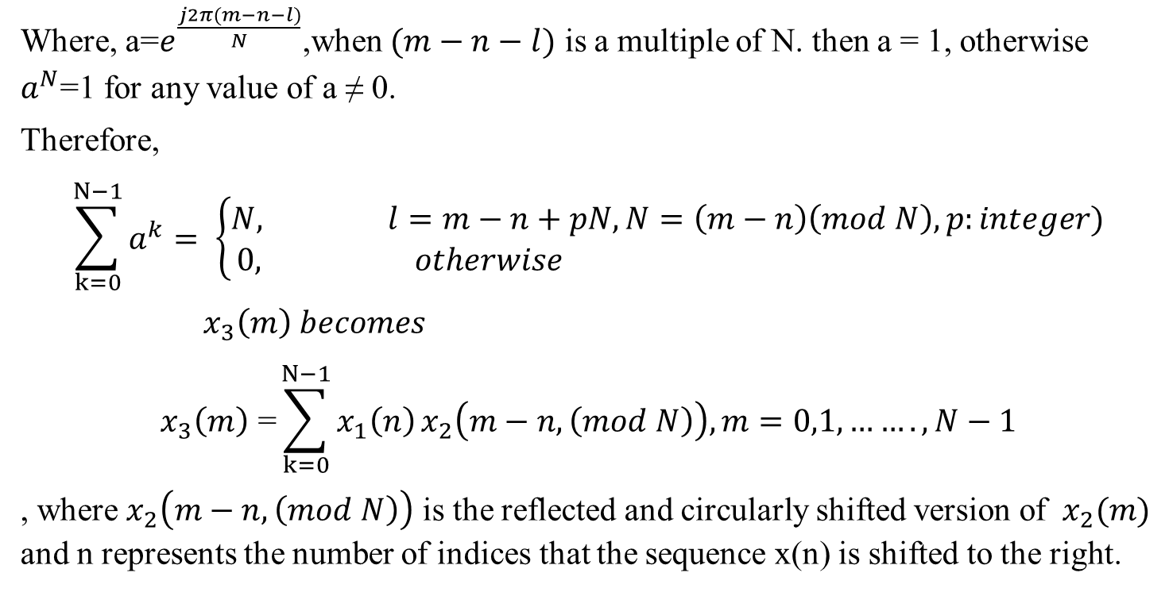
Where, a=$e^{\frac{j2π(m−n−l)}{N}}$,when $(m−n−l)$ is a multiple of N. then a = 1, otherwise $a^{N}$=1 for any value of a ≠ 0.
Therefore,
$$\sum_{k=0}^{N−1}{a^{k}= \left\{\begin{aligned}N, l=m−n+pN,N=\left(m−n\right)\left(mod N\right),p:integer) \\ 0, otherwise \end{aligned}\right.}$$
$x_{3}\left(m\right) becomes$
$$x_{3}\left(m\right)\text{ =}\sum_{k=0}^{N−1}{x_{1}\left(n\right)}x_{2}\left(m−n,\left(mod N\right)\right), m=0,1,…….,N−1$$
, where $x_{2}\left(m−n,\left(mod N\right)\right)$ is the reflected and circularly shifted version of $x_{2}(m)$ and n represents the number of indices that the sequence x(n) is shifted to the right.

Slide 5
The above equation has a form similar to the convolution sum and it is called circular convolution The circularly shifted versions of x(m) are given below:
x(m) =[x(0),x(1)…x(N-3),x(N-2),x(N-1)]
x(m-1,(mod N))=[ x(N-1),x(0),x(1)…x(N-3),x(N-2)]
x(m-2,(mod N))=[ x(N-2),x(N-1),x(0),x(1)…x(N-3)]
.
.
.
x(m-n,(mod N))=[ x(N-n),x(N-n+1)..…x(N-n-1)]
.
.
.
x(m-N,(mod N))=[ x(0),x(1)..…x(N-3),x(N-2),x(N-1)]
It just noted that a shift of n=N results in the original signal x(m).

Slide 6
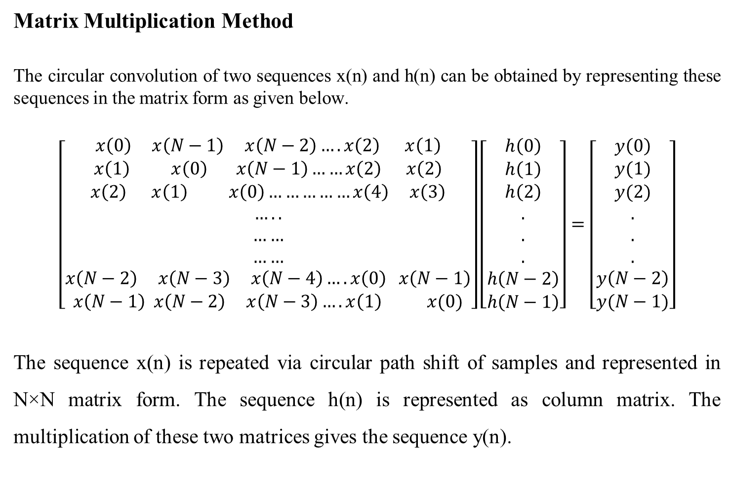
Matrix Multiplication Method
The circular convolution of two sequences x(n) and h(n) can be obtained by representing these sequences in the matrix form as given below.
$$\left[\begin{aligned}x\left(0\right) x\left(N−1\right) x\left(N−2\right)….x\left(2\right) x\left(1\right) \\ x\left(1\right) x\left(0\right) x\left(N−1\right)……x\left(2\right) x\left(2\right) \\ x\left(2\right) x\left(1\right) x\left(0\right)……………x\left(4\right) x\left(3\right) \\ ….. \\ …… \\ …… \\ x\left(N−2\right) x\left(N−3\right) x\left(N−4\right)….x\left(0\right) x\left(N−1\right) \\ x\left(N−1\right) x\left(N−2\right) x\left(N−3\right)….x\left(1\right) x(0)\end{aligned}\right]\left[\begin{aligned}h\left(0\right) \\ h\left(1\right) \\ h\left(2\right) \\ . \\ . \\ . \\ h\left(N−2\right) \\ h\left(N−1\right)\end{aligned}\right]=\left[\begin{aligned}y\left(0\right) \\ y(1) \\ y(2) \\ . \\ . \\ . \\ y\left(N−2\right) \\ y(N−1)\end{aligned}\right]$$
The sequence x(n) is repeated via circular path shift of samples and represented in N×N matrix form. The sequence h(n) is represented as column matrix. The multiplication of these two matrices gives the sequence y(n).

Slide 7
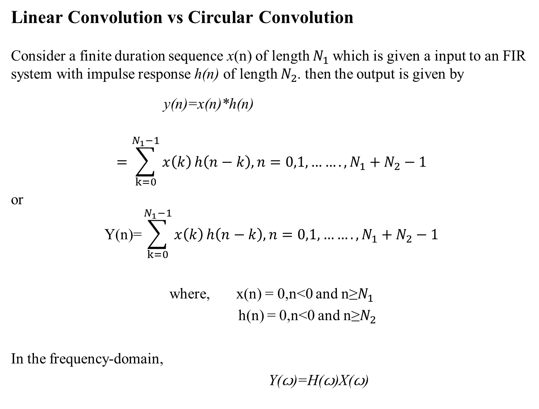
Linear Convolution vs Circular Convolution
Consider a finite duration sequence x(n) of length $N_{1}$which is given a input to an FIR system with impulse response h(n) of length $N_{2}$. then the output is given by
y(n)=x(n)*h(n)
$$=\sum_{k=0}^{N_{1}−1}{x\left(k\right)}h\left(n−k\right), n=0,1,…….,N_{1}+N_{2}−1$$
or
$$\text{Y}\text{(}\text{n}\text{)=}\sum_{k=0}^{N_{1}−1}{x\left(k\right)}h\left(n−k\right), n=0,1,…….,N_{1}+N_{2}−1$$
where, x(n) = 0,n<0 and n≥$N_{1}$
h(n) = 0,n<0 and n≥$N_{2}$
In the frequency-domain,
Y(ꙍ)=H(ꙍ)X(ꙍ)

Slide 8
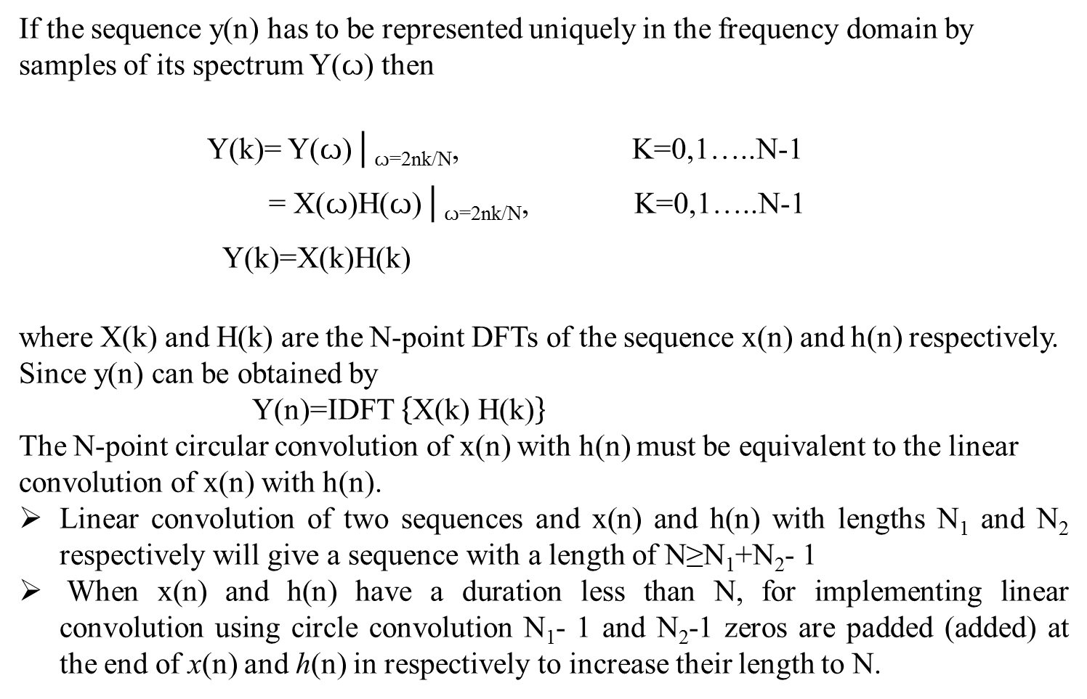
If the sequence y(n) has to be represented uniquely in the frequency domain by samples of its spectrum Y(ꙍ) then
Y(k)= Y(ꙍ)│_{ꙍ=2nk­/N}, K=0,1…..N-1
= X(ꙍ)H(ꙍ)│_{ꙍ=2nk­/N}, K=0,1…..N-1
Y(k)=X(k)H(k)
where X(k) and H(k) are the N-point DFTs of the sequence x(n) and h(n) respectively.
Since y(n) can be obtained by
Y(n)=IDFT $\left\{\text{X}\text{(}\text{k}\text{) }\text{H}\text{(}\text{k}\text{)}\right\}$
The N-point circular convolution of x(n) with h(n) must be equivalent to the linear convolution of x(n) with h(n).
Linear convolution of two sequences and x(n) and h(n) with lengths N₁ and N₂ respectively will give a sequence with a length of N≥N₁+N₂- 1
When x(n) and h(n) have a duration less than N, for implementing linear convolution using circle convolution N₁- 1 and N₂-1 zeros are padded (added) at the end of x(n) and h(n) in respectively to increase their length to N.

Slide 9
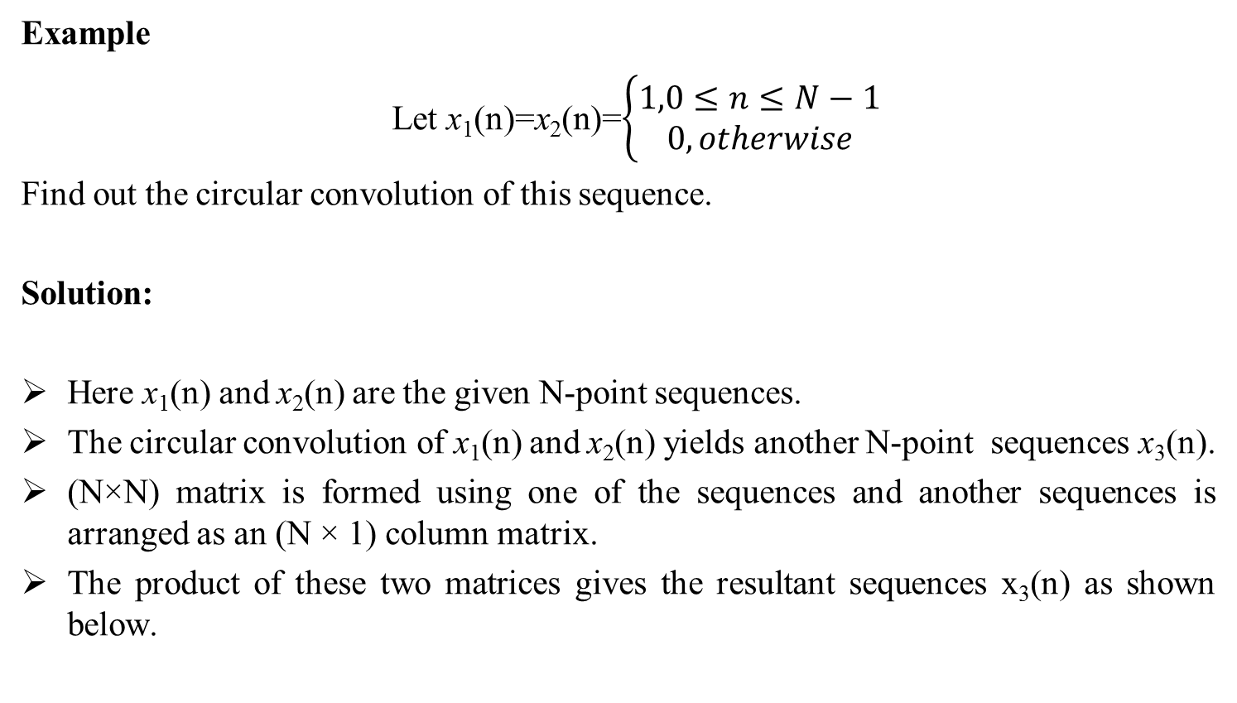
Example
Let x₁(n)=x₂(n)=$\left\{\begin{aligned}1,0≤n≤N−1 \\ 0,otherwise\end{aligned}\right.$
Find out the circular convolution of this sequence.
Solution:
Here x₁(n) and x₂(n) are the given N-point sequences.
The circular convolution of x₁(n) and x₂(n) yields another N-point sequences x₃(n).
(N×N) matrix is formed using one of the sequences and another sequences is arranged as an (N × 1) column matrix.
The product of these two matrices gives the resultant sequences x₃(n) as shown below.

Slide 10
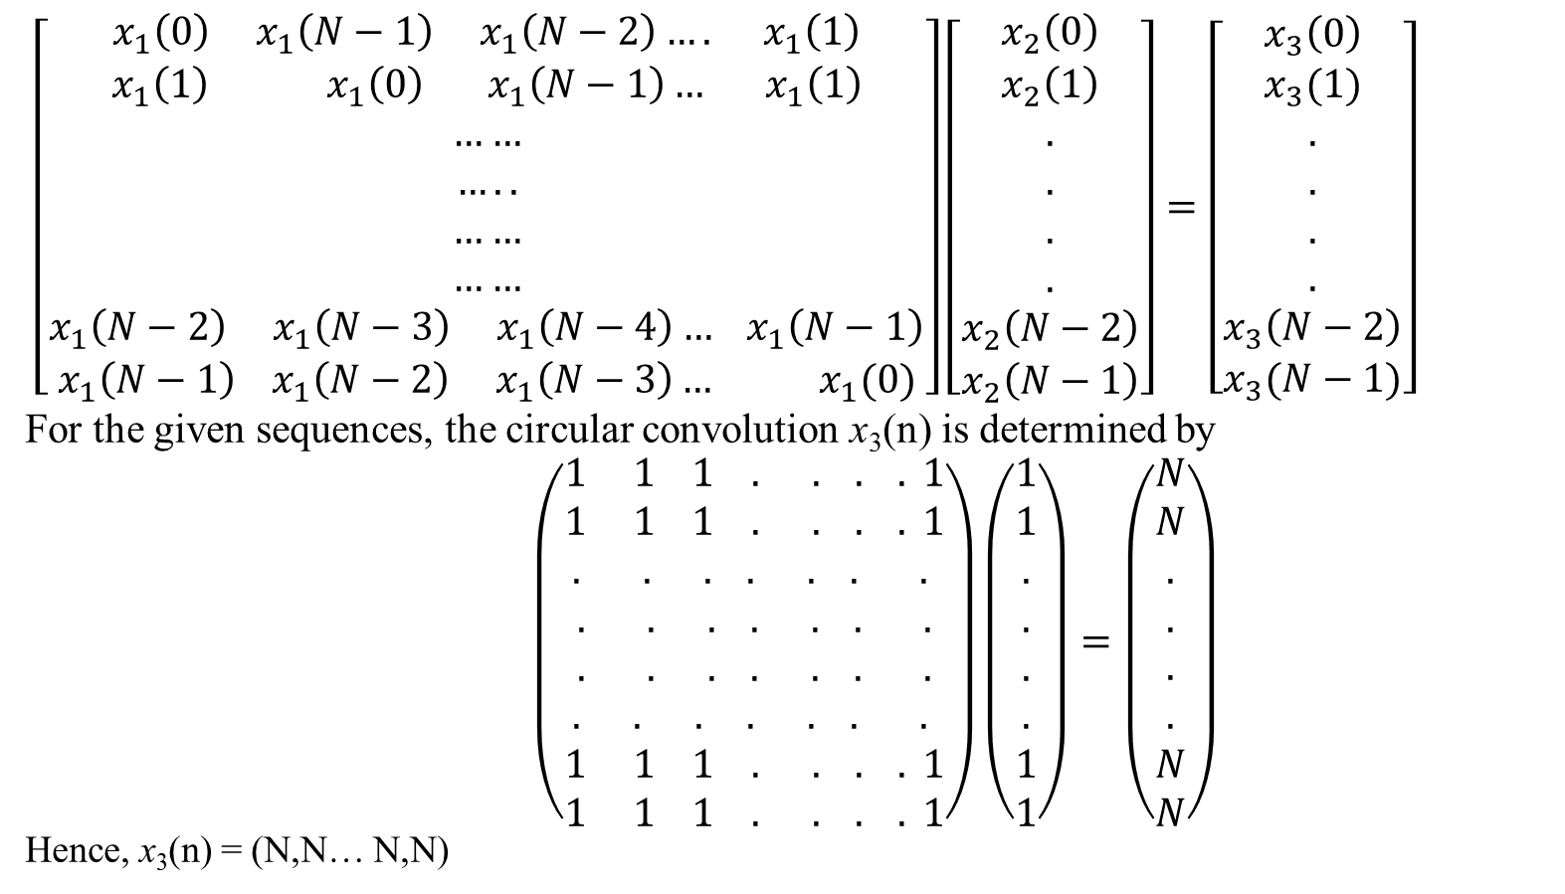
Using matrix approach, we can formulate circular convolution as
$\left[\begin{aligned}x_{1}\left(0\right) x_{1}\left(N−1\right) x_{1}\left(N−2\right)…. x_{1}\left(1\right) \\ x_{1}\left(1\right) x_{1}\left(0\right) x_{1}\left(N−1\right)… x_{1}\left(1\right) \\ …… \\ ….. \\ …… \\ …… \\ x_{1}\left(N−2\right) x_{1}\left(N−3\right) x_{1}\left(N−4\right)… x_{1}\left(N−1\right) \\ x_{1}\left(N−1\right) x_{1}\left(N−2\right) x_{1}\left(N−3\right)… x_{1}(0)\end{aligned}\right]\left[\begin{aligned}x_{2}\left(0\right) \\ x_{2}\left(1\right) \\ . \\ . \\ . \\ . \\ x_{2}\left(N−2\right) \\ x_{2}\left(N−1\right)\end{aligned}\right]=\left[\begin{aligned}x_{3}\left(0\right) \\ x_{3}(1) \\ . \\ . \\ . \\ . \\ x_{3}\left(N−2\right) \\ x_{3}(N−1)\end{aligned}\right]$
For the given sequences, the circular convolution x₃(n) is determined by
$\left(\begin{aligned}1 1 1 . . . . 1 \\ 1 1 1 . . . . 1 \\ . . . . . . . \\ . . . . . . . \\ . . . . . . . \\ . . . . . . . \\ 1 1 1 . . . . 1 \\ 1 1 1 . . . . 1\end{aligned}\right)\left(\begin{aligned}1 \\ 1 \\ . \\ . \\ . \\ . \\ 1 \\ 1\end{aligned}\right)=\left(\begin{aligned}N \\ N \\ . \\ . \\ . \\ . \\ N \\ N\end{aligned}\right)$
Hence, x₃(n) = (N,N… N,N)

